Slide 1
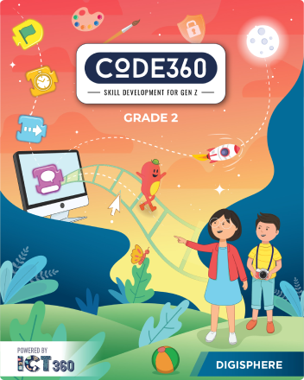
Mazen
Saad
Computer teacher

Slide 2
ICT
Grade 2

Slide 3
Lesson title
Create Documents
The Date
2025 / 11 / 2

Slide 4

Create Documents

Slide 5






Do you know what a Documents is

Slide 6
document is a file that contains information.

Slide 7

This can be

Slide 8

text

Slide 9
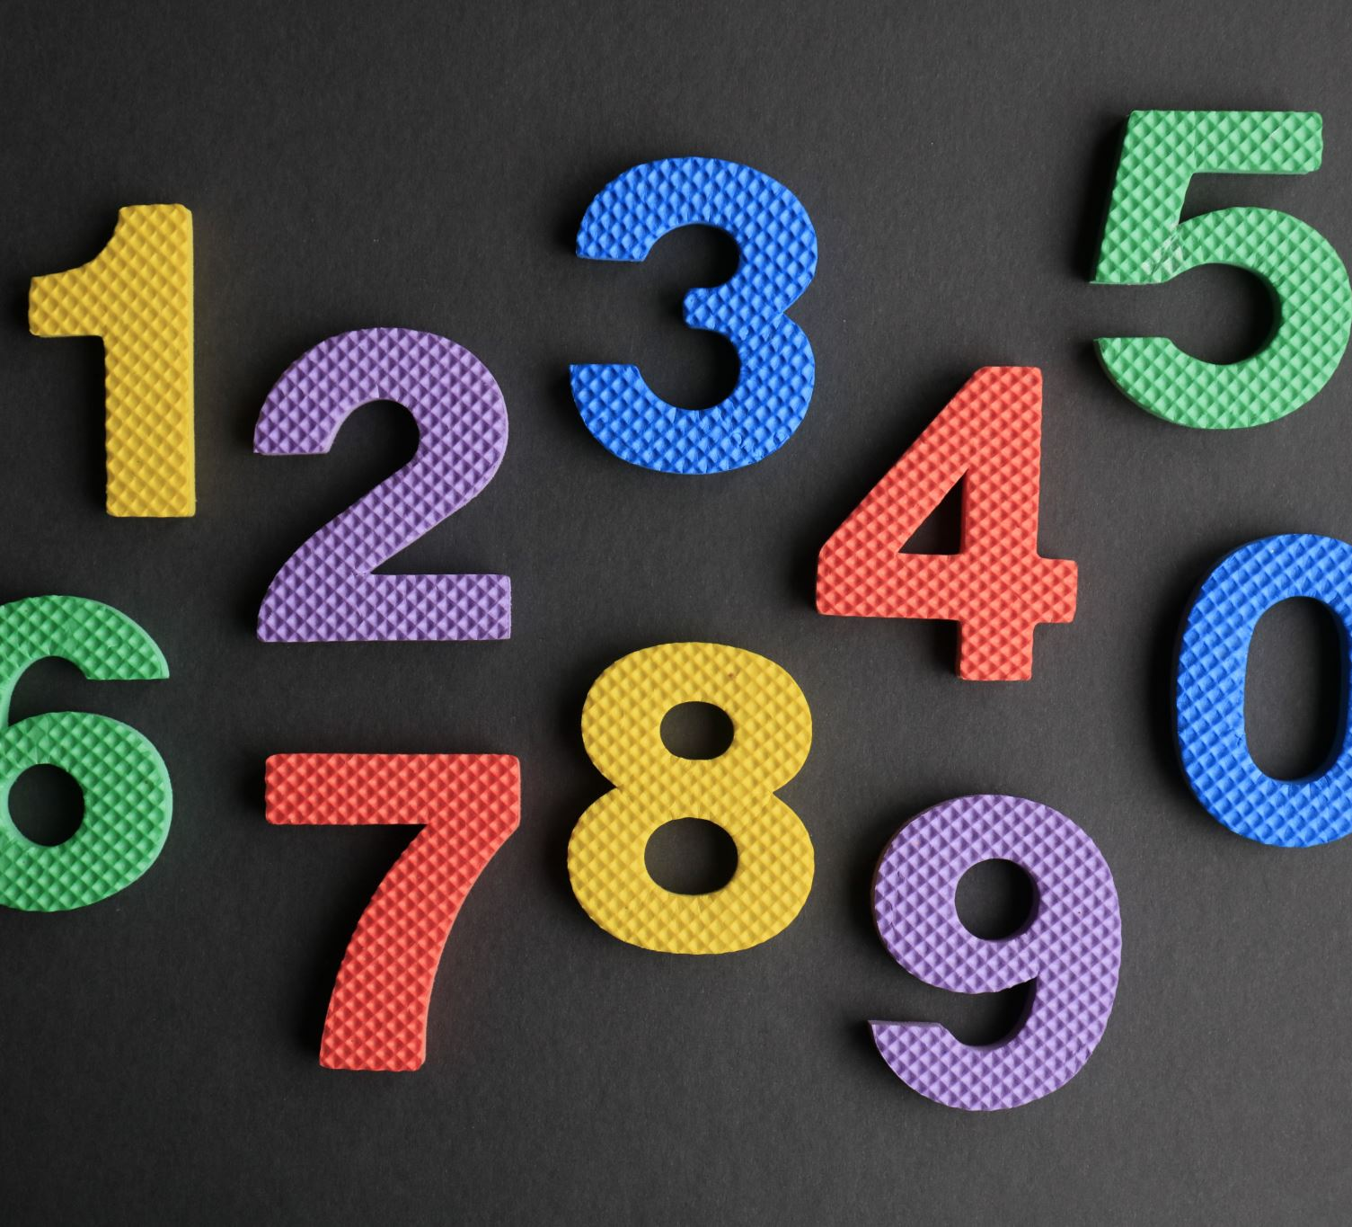
Numbers

Slide 10
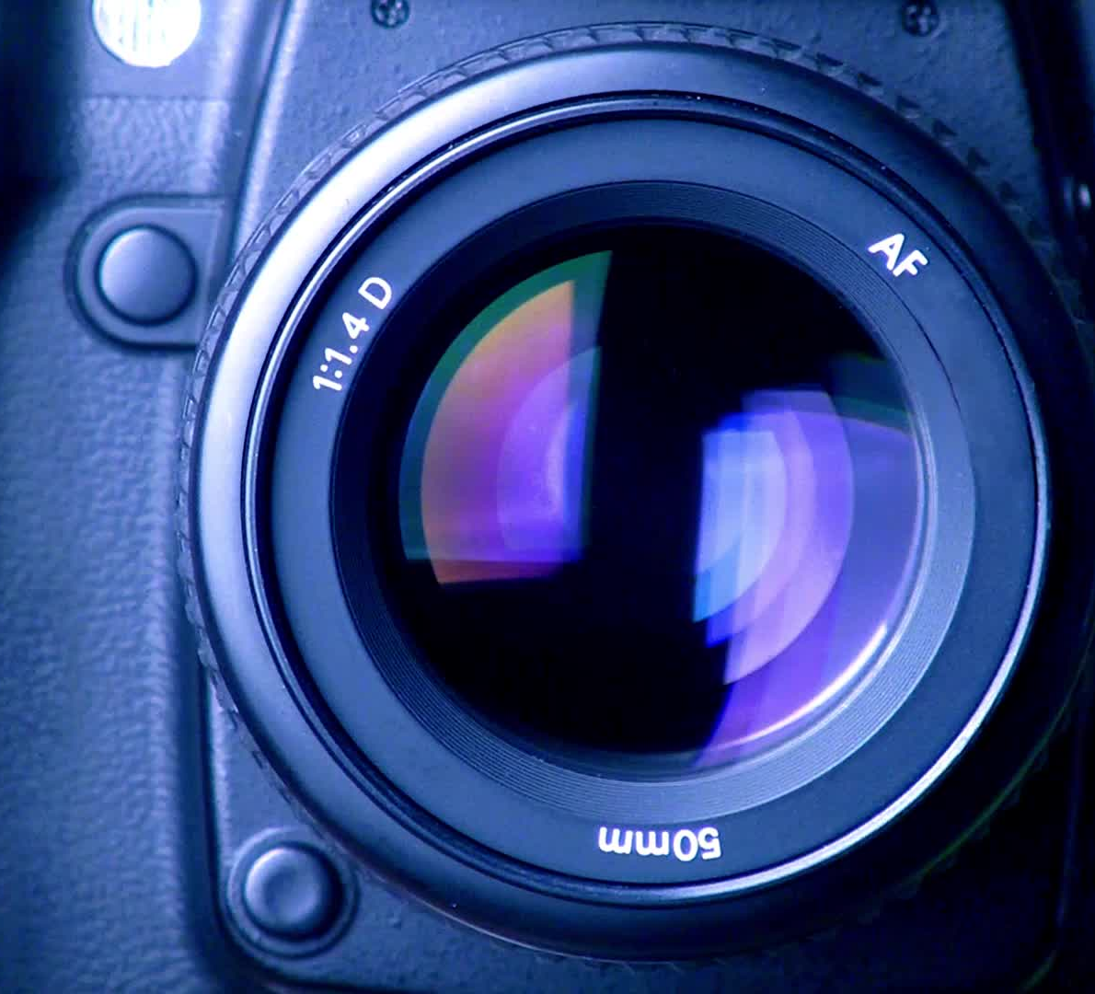
images

Slide 11
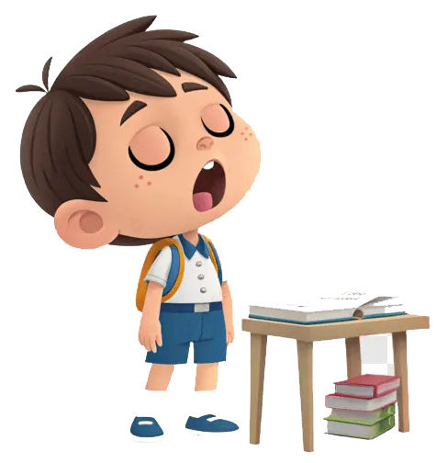
We follow the explanation
Yes Or No

Slide 12

Do you know the steps to create a Document

Slide 13

First step

Slide 14
MS Word is a software that allows us to add images and changetext style in a document. We can also add tables, colours, andshapes. A document created with MS Word is called as a WordDocument.

Slide 15

MS Word is a software that allows us to add images and changetext style in a document. We can also add tables, colours, andshapes. A document created with MS Word is called as a WordDocument.

